Slide 1


DisenKGAT: Knowledge Graph Embedding with Disentangled Graph Attention Network
Authors: Junkang Wu, Wentao Shi, Xuezhi Cao, Jiawei Chen*, Wenqiang Lei, Fuzheng Zhang, Wei Wu, Xiangnan He
Paper: https://arxiv.org/abs/2108.09628
Lab: USTC Lab for Data Science
Code: https://github.com/Wjk666/DisenKGAT
Date: Sep 29, 2021
Notes:
Hello, everyone! I would like to introduce our novel work on Knowledge graph Embedding with Disentangled representation. The overall report is categorized into four parts: Background and Motivation; our model: DisenKGAT, Experiments, and summary.

Slide 2
Outline
Background and Motivation
our Model: DisenKGAT
Experiments
Summary
Notes:
The overall report is categorized into four parts: Background and Motivation; our model: DisenKGAT, Experiments, and summary.

Slide 3
Background and Motivation
Knowledge Graphs (KGs) is a structured representation of facts, consisting of entities, relationships and semantic descriptions.
applied in dialogue generation, question answering, recommender systems.
changed the paradigm for numerous state-of-the-art natural language processing solutions.
An example of knowledge base and knowledge graph
Figure credit to S. Ji’s survey (A Survey on Knowledge Graphs: Representation, Acquisition and Applications)
Notes:
In recent years, knowledge graphs (KG) aroused considerable research interest since they changed the paradigm for numerous state-of-the-art natural language processing solutions and enhanced AI-related applications. Representative applications include e.g.,dialogue generation [9], question answering [20], recommender systems [44]. However, modern KGs are still far away from complete due to the constantly emerging new knowledge.

Slide 4
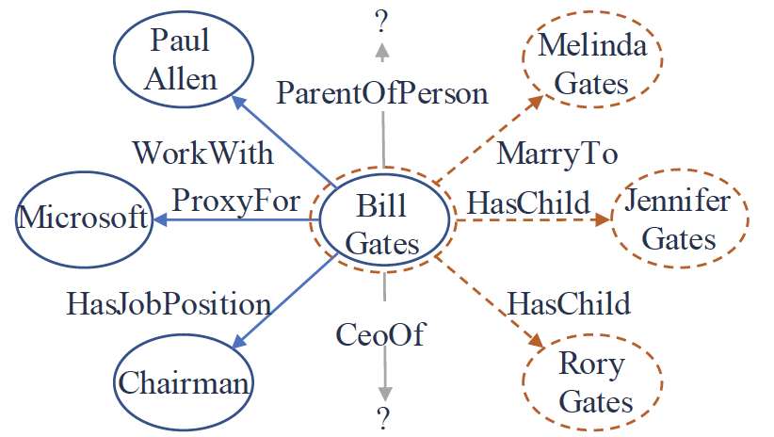
Background and Motivation
Knowledge Graphs (KGs) is a structured representation of facts, consisting of entities, relationships and semantic descriptions.
Due to the constantly emerging new knowledge, they are still far away from completeness
Figure credit to J. sheng et al. 2020 Adaptive Attentional Network for Few-Shot
Knowledge Graph Completion
Notes:
In recent years, knowledge graphs (KG) aroused considerable research interest since they changed the paradigm for numerous state-of-the-art natural language processing solutions and enhanced AI-related applications. Representative applications include e.g.,dialogue generation [9], question answering [20], recommender systems [44]. However, modern KGs are still far away from complete due to the constantly emerging new knowledge.

Slide 5
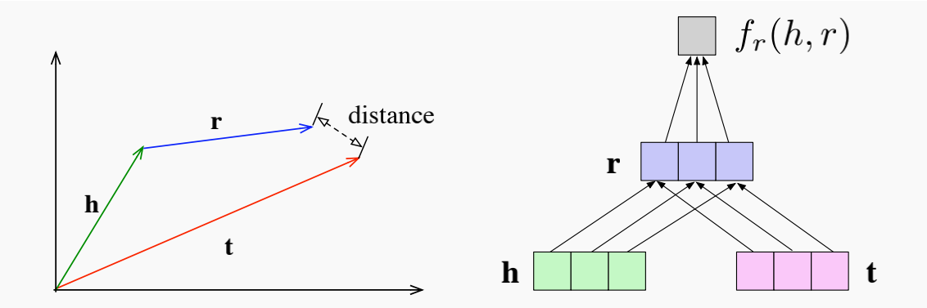
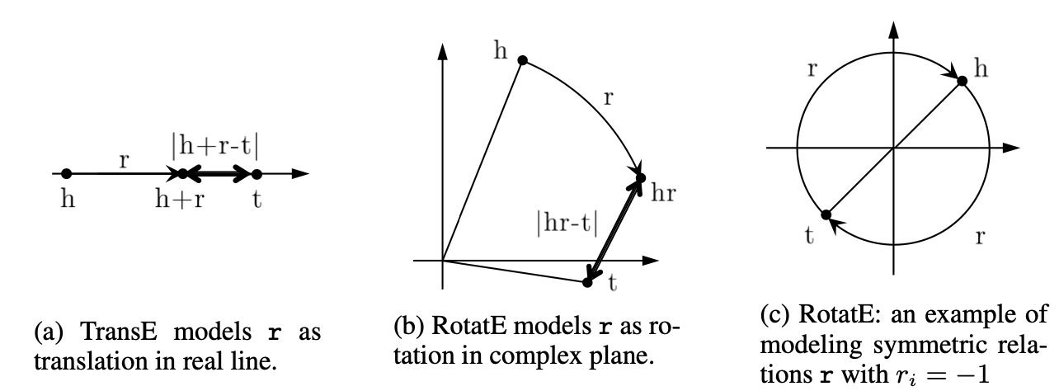
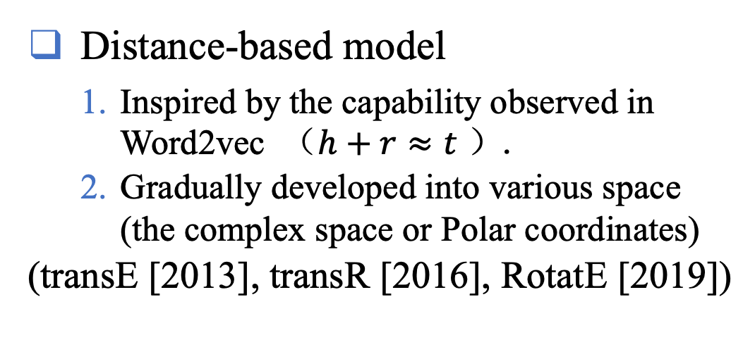
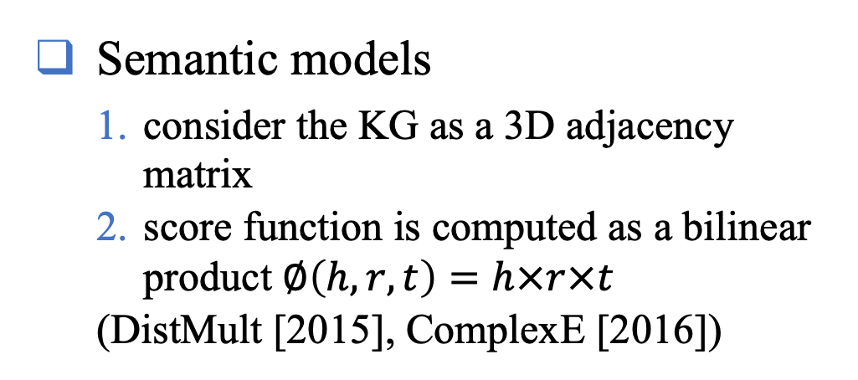
Knowledge Graph Embedding
Distance-based model
Inspired by the capability observed in Word2vec （$h+r≈t$ ）.
Gradually developed into various space (the complex space or Polar coordinates)
(transE [2013], transR [2016], RotatE [2019])
Semantic models
consider the KG as a 3D adjacency matrix
score function is computed as a bilinear product $∅\left(h,r,t\right)=h×r×t$
(DistMult [2015], ComplexE [2016])
Figure credit to Z. Sun et al. 2019 ICLR ROTATE: KNOWLEDGE GRAPH EMBEDDING BY RELATIONAL
ROTATION IN COMPLEX SPACE
Figure credit to S. Ji’s survey (A Survey on Knowledge Graphs: Representation, Acquisition and Applications)
Notes:
In literature, most KGC models are based on knowledge graph embedding, which could be classified into 3types:
The distanced-based model is inspired by the capability observed in Word2vec which is also called the translation model. The semantic model considers the knowledge graph as a 3D adjacency matrix. The core idea is that learned embeddings should be able to generalize, and associate high values to unseen facts in the graph adjacency matrix. Neural network-based models leverage all kinds of neural such as convolution networks to model the interaction. With the rapid development of graph convolution networks, it gradually constructs an encoder-decoder paradigm in knowledge graph completion.
All in all, the key idea is that defining a score function at first to measure the plausibility of the given triplets and then making sure positive samples have higher scores than negative samples.

Slide 6
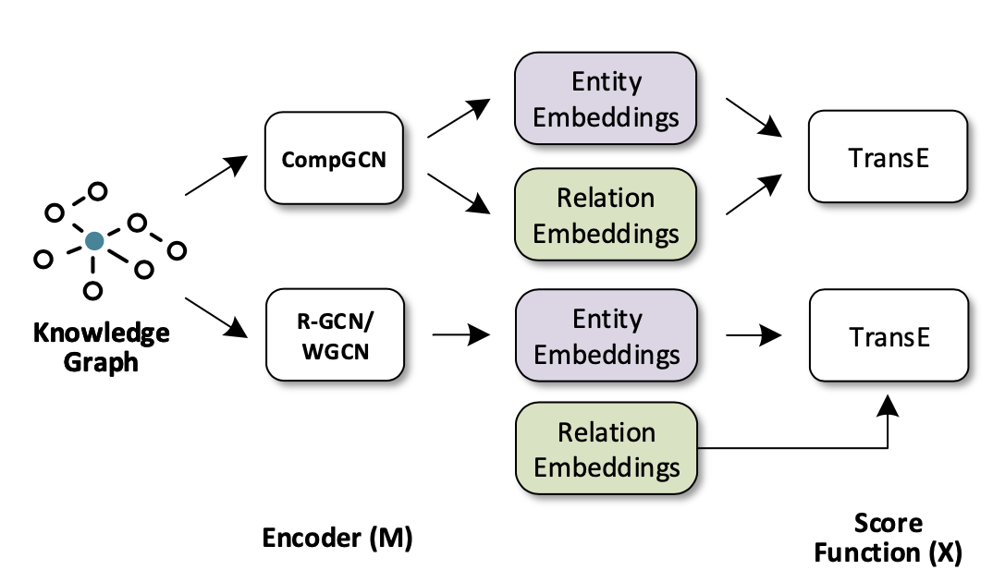
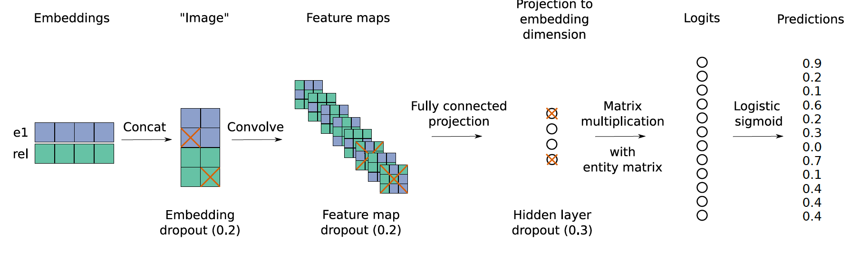
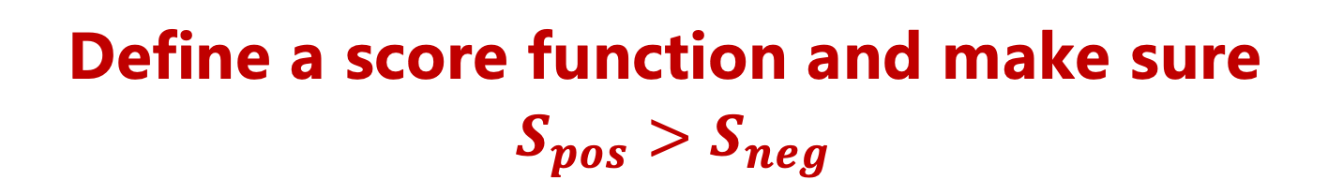
Knowledge Graph Embedding
Neural network based models
leverage 2D convolution network to model the interaction.
GCN constructs the encoder-decoder paradigm in knowledge graph completion.
(ConvE [2018], SACN [2019],
CompGCN [2020])
Define a score function and make sure
$S_{pos}>S_{neg}$
Notes:
In literature, most KGC models are based on knowledge graph embedding, which could be classified into 3types:
The distanced-based model is inspired by the capability observed in Word2vec which is also called the translation model. The semantic model considers the knowledge graph as a 3D adjacency matrix. The core idea is that learned embeddings should be able to generalize, and associate high values to unseen facts in the graph adjacency matrix. Neural network-based models leverage all kinds of neural such as convolution networks to model the interaction. With the rapid development of graph convolution networks, it gradually constructs an encoder-decoder paradigm in knowledge graph completion.
All in all, the key idea is that defining a score function at first to measure the plausibility of the given triplets and then making sure positive samples have higher scores than negative samples.

Slide 7
Drawbacks
Ignore the entanglement of the latent factors behind the entity embeddings.
The static representation fails to effectively model the critical relationship
In the light of the above two points, these methods result in low interpretability and non-robustness.
Notes:
Although significant progress has been made by those models, static representation still limits the flexibility and expressiveness of the embeddings. On the one hand, They ignore the entanglement of the latent factors behind the entities while an entity may have multiple aspects. As the example in Figure 1 (b), the entity "Kobe Brant" is associated with different task components such as "Family", "Career", "Place" and "awards". On the other hand, the static aggregating neighborhood entities fail to effectively model the critical relationship that is significant in characterizing the local information in a specific scenario. Take the query (Kobe, profession, ?) and query(Bill Gates, profession, ?) as an example, owning to the common nationalities (“America”) of “Bill Gates” and “Kobe”, existing methods will naturally pull the representations of Kobe and Bill Gates closer to capture such identity. However, in terms of the relation "profession", where the two people indeed exhibit quite a difference.

Slide 8
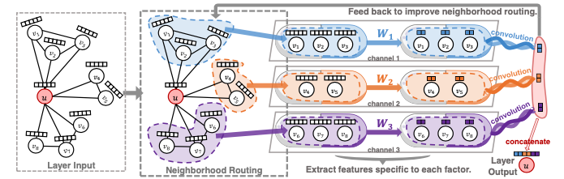
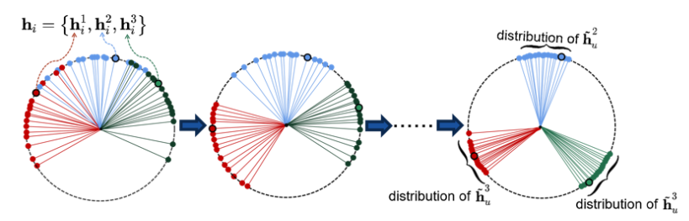
Research Goal and Challenges
Goal: provide a novel Disentangled Knowledge graph embedding framework which could predict adaptively according to the given scenario.
Capture the latent factor^{[1]}.
Micro-disentanglement and Macro-disentanglement^{[2, 3]}.
Figure credit to J. Ma et al. Disentangled graph convolutional networks, ICML2019 and S. Zheng et al. Adversarial Graph Disentanglement
[1]Jianxin Ma, et al. Disentangled graph convolutional networks. In ICML2019.
[2] Yanbei Liu, et al 2020. Independence promoted graph disentangled networks. In AAAI2020
[3] Shuai Zheng, et al. Adversarial Graph Disentanglement. 2021 arXiv preprint arXiv:2103.07295(2021)
Notes:
So, our goal is to provide a disentangled knowledge graph embedding framework that could predict adaptively according to ht given scenario. The challenging parts are how to capture the latent factor in a complex knowledge graph and how to utilize the micro-disentangled and macro-disentanglement. recent work adopt gan or linear distance to achieve micro-and macro- disentanglement to ensure independent properties

Slide 9
Framework
An architecture overview of our DisenKGAT. The whole model contains three key modules: (1) relation-aware aggregation, (2) independence constraint, and (3) adaptive scoring.
Notes:
The whole model contains three modules. Each channel (color) represents a specific component and different components keep individuals with each other by the correlation restriction. The final prediction result depends on all components of the entities and is adaptive to the given scenario (relation).

Slide 10
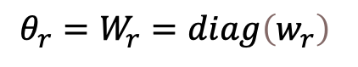
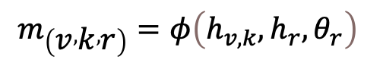
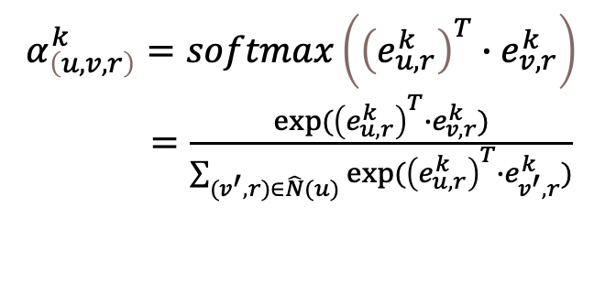
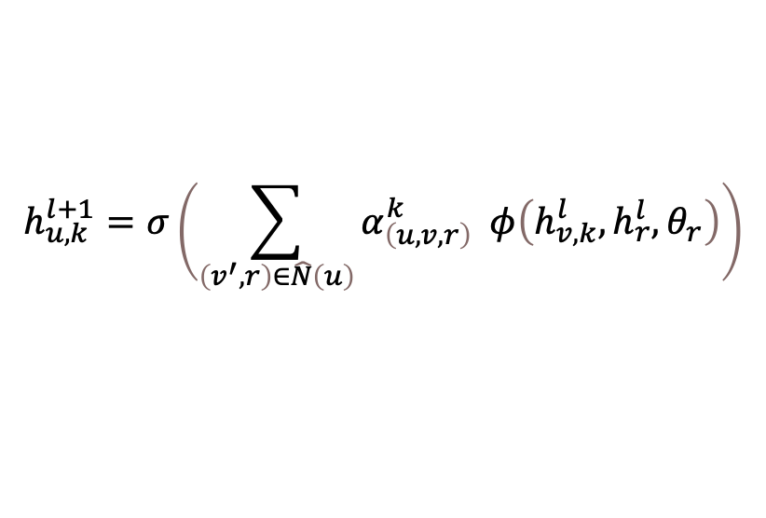
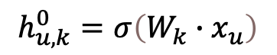
Model
Disentangled Transformation
$$h_{u,k}^{0}=σ\left(W_{k}∙x_{u}\right)$$
Normalization will hurt the final performance
Relation-aware Aggregation
$$m_{\left(v , k , r\right)}=φ\left(h_{v,k},h_{r},θ_{r}\right)$$
Explicitly combine crucial information-the edge relation
$$θ_{r}=W_{r}=diag\left(w_{r}\right)$$
$$α_{\left(u,v,r\right)}^{k}=softmax\left({\left(e_{u,r}^{k}\right)}^{T}∙e_{v,r}^{k}\right)$$
$=\frac{exp({\left(e_{u,r}^{k}\right)}^{T}∙e_{v,r}^{k})}{\sum_{(v^{′},r)∈\hat{N}(u)}{exp({\left(e_{u,r}^{k}\right)}^{T}∙e_{v^{′},r}^{k})}}$
the more similar the entity 𝑢 and the neighbor 𝑣 are in the 𝑘-th component in terms of their relation 𝑟 , the more likely the factor 𝑘 is to be the reason for the connection.
$$h_{u,k}^{l+1}=σ\left(\sum_{\left(v^{′},r\right)∈\hat{N}\left(u\right)}{α_{\left(u,v,r\right)}^{k} φ\left(h_{v,k}^{l},h_{r}^{l},θ_{r}\right)}\right)$$
Notes:
Let's go to the model deeply, Firstly, we linear transformation to generate K independent components. Note that here we do not use any normalization such as BatchNorm [10] or LayerNorm [1], as we empirically find it ineffective in our task. To achieve micro-disentanglement, we propose a relation-aware aggregation that explicitly combines crucial information -the edge relation. And we simply adopt the dot-product(DP) attention based on the hypothesis that the more similar the entity 𝑢 and the neighbor 𝑣 are in the 𝑘-the component in terms of their relation 𝑟, the more likely the factor 𝑘 is to be the reason for the connection.

Slide 11
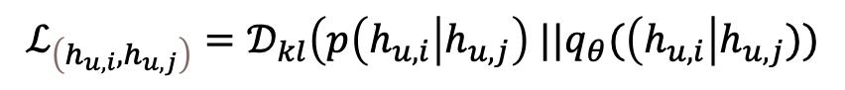
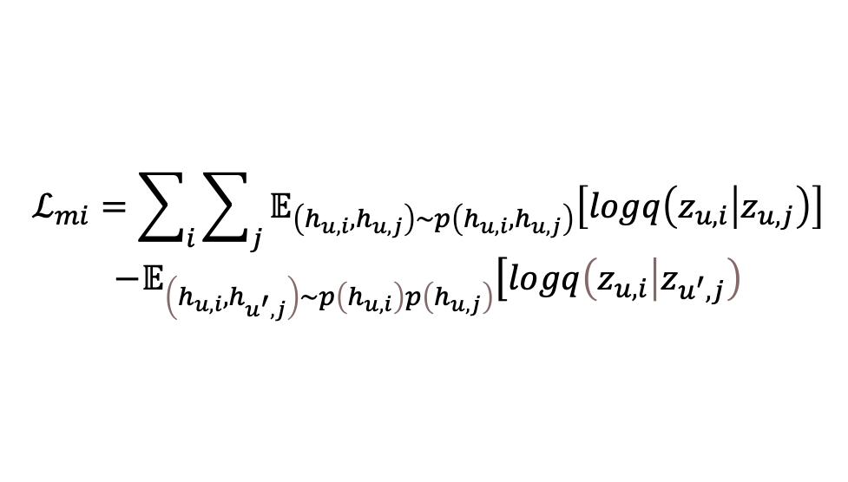
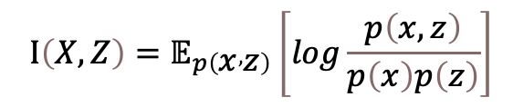
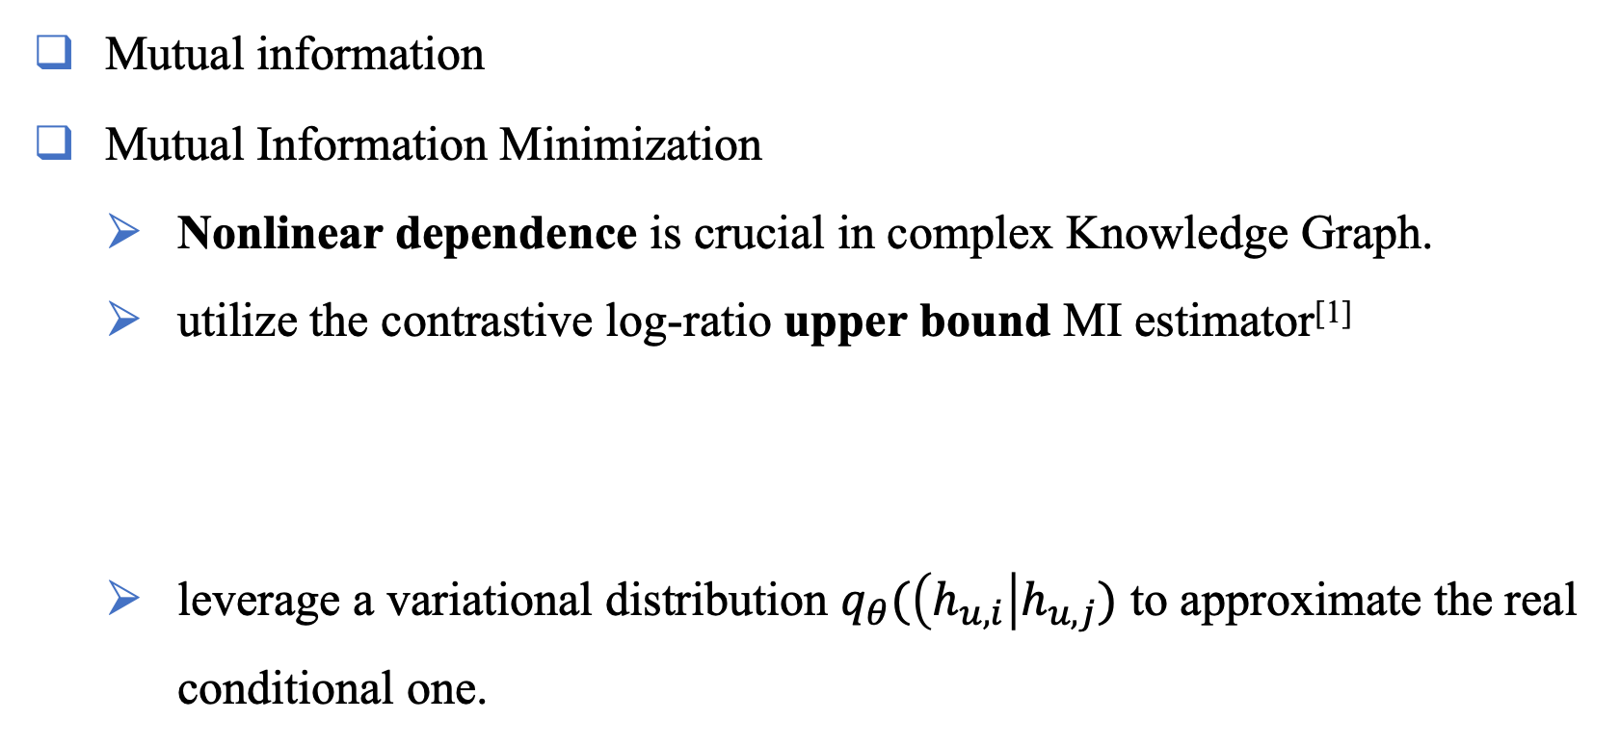
Model
Independence Constraint
$$Ι\left(X,Z\right)=𝔼_{p\left(x , z\right)}\left[log\frac{p\left(x,z\right)}{p\left(x\right)p\left(z\right)}\right]$$
Mutual information
Mutual Information Minimization
Nonlinear dependence is crucial in complex Knowledge Graph.
utilize the contrastive log-ratio upper bound MI estimator^{[1]}
leverage a variational distribution $q_{θ}(\left(h_{u,i}\right|h_{u,j})$ to approximate the real conditional one.
$$ℒ_{mi}=\sum_{i}{\sum_{j}{𝔼_{\left(h_{u,i},h_{u,j}\right)\sim p\left(h_{u,i},h_{u,j}\right)}\left[logq\left(z_{u,i} | z_{u,j}\right)\right]}}$$
$$−𝔼_{\left(h_{u,i},h_{u^{′},j}\right)\sim p\left(h_{u,i}\right)p\left(h_{u,j}\right)}\left[logq\left(z_{u,i} | z_{u^{′},j}\right)\right.$$
$$ℒ_{\left(h_{u,i},h_{u,j}\right)}=𝒟_{kl}\left(p\left(h_{u,i}\right|h_{u,j}\right) ||q_{θ}(\left(h_{u,i}\right|h_{u,j}))$$
[1] Pengyu Chenge.et al. CLUB: A Contrastive Log-ratio Upper Bound of Mutual Information. 2020ICML
Notes:
To achieve macro-disentanglement, we expect that be a weak dependence among the different component representations. Here, we leverage mutual information as our regularization. Notice that focus on the Disentangled scenario, we utilize a contrastive MI estimator to minimize the upper bound of different components' mutual information. Owing to conditional probability is unavailable, we leverage a variational distribution q to approximate the real one.

Slide 12


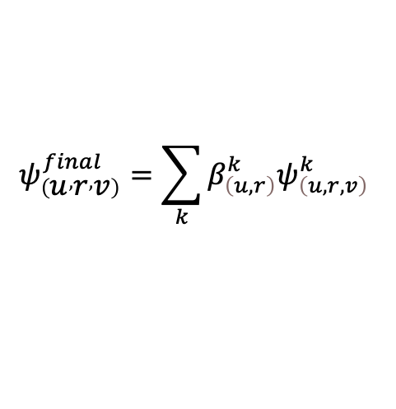
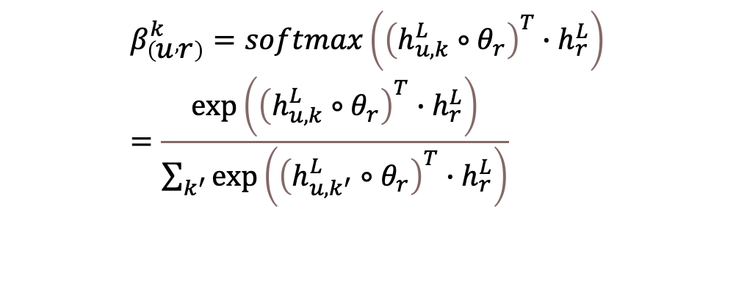
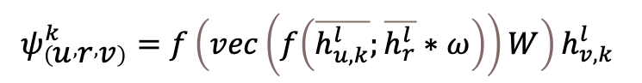
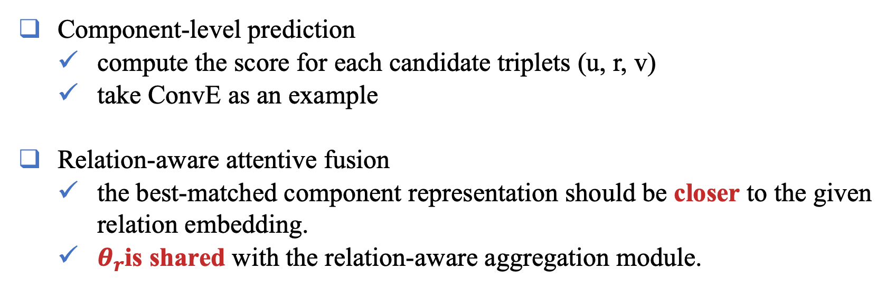
Model
Adaptive Scoring
Component-level prediction
compute the score for each candidate triplets (u, r, v)
take ConvE as an example
Relation-aware attentive fusion
the best-matched component representation should be closer to the given relation embedding.
$θ_{r}$is shared with the relation-aware aggregation module.
$$ψ_{\left(u , r , v\right)}^{k}=f\left(vec\left(f\left(\overline{h_{u,k}^{l}};\overline{h_{r}^{l}}∗ω\right)\right)W\right)h_{v,k}^{l}$$
$$β_{\left(u , r\right)}^{k}=softmax\left({\left(h_{u,k}^{L}∘θ_{r}\right)}^{T}∙h_{r}^{L}\right)=\frac{\exp\left({\left(h_{u,k}^{L}∘θ_{r}\right)}^{T}∙h_{r}^{L}\right)}{\sum_{k^{′}}{\exp\left({\left(h_{u,k^{′}}^{L}∘θ_{r}\right)}^{T}∙h_{r}^{L}\right)}}$$
Barack Obama | mother | Anne Dunham
Barack Obama | career | president
Barack Obama | Married_to | Michelle Obama
Michelle Obama | Daughter | Malia Ann Obama
Barack Obama | Daughter | ???
$$ψ_{\left(u , r , v\right)}^{final}=\sum_{k}{β_{\left(u,r\right)}^{k}ψ_{\left(u,r,v\right)}^{k}}$$
Notes:
adaptive scoring is composed of component-level prediction and relation-aware attention fusion. We could choose any score functions as in the component level. And in relation-aware attention fusion, we expect that the best-matched component should be closer to the given relation embeddings. For example, we have got some triplets about Obama, such as his mother, his career, his daughter, and his wife. When it comes to asking Obama's other daughter, the Topic of family's related neighbors should be assigned with higher attention.

Slide 13
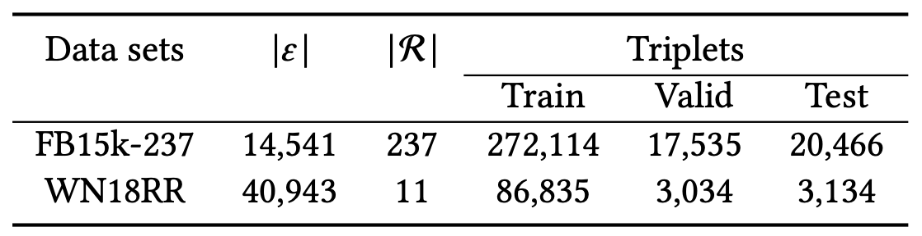
Experiment
How does DisenKGAT perform compared to existing aproaches, w.r.t. distance-based and semantic matching models?
How do the critical components (e.g., relation-aware aggregation) contribute to DisenKGAT and how do different hyperparameters (e.g., factor number) affect DisenKGAT?
Does DisenKGAT work robustly with other decoder modules?
Can DisenKGAT give explanations of the benefits brought by the disentangled factors?
Baseline:
Distance-based model (TransE, RotatE )
Semantic models (DistMult, RESCAL)
Neural network based models (ConvE, InteractE, SACN, ArcE, ReinceptionE, COMPGCN)
Notes:
As for experiments, we put forward four questions and design the related experiments. Below are the baseline and dataset used in our experiments.

Slide 14
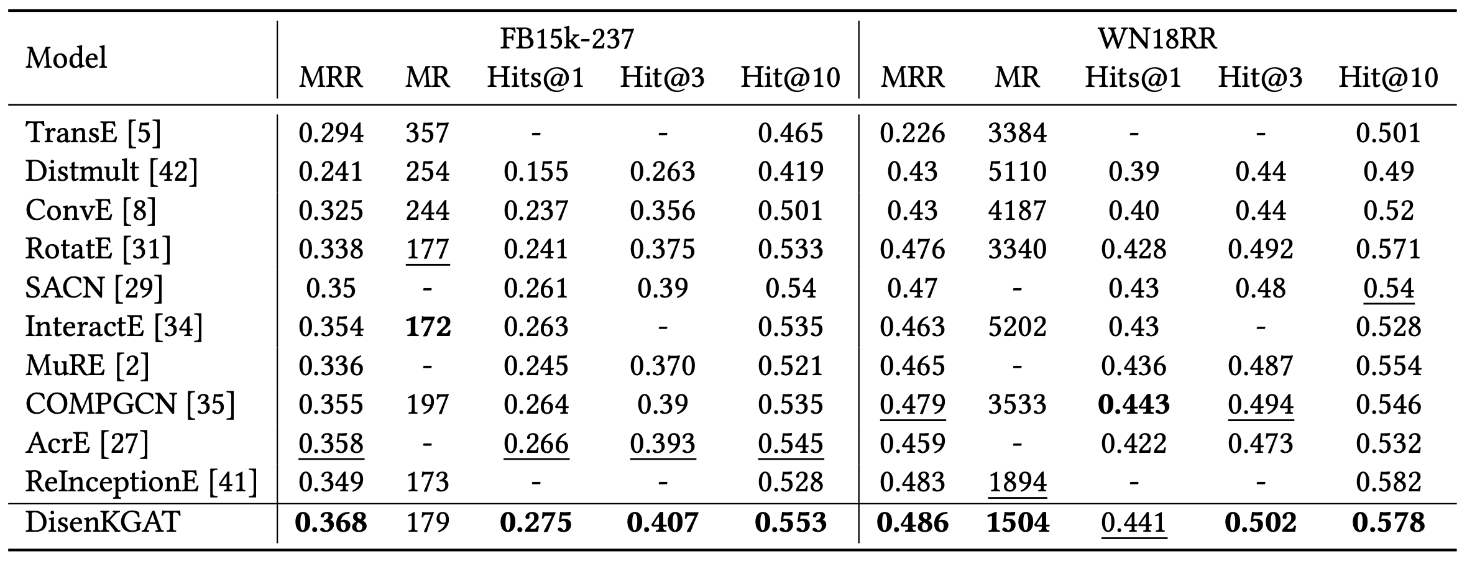
Performance
DisenKGAT achieve a considerable improvement on FB15k-237 which includes 237 relations
WN18RR only contain 11 relation types.
Notes:
DisenKGAT achieves a considerable improvement on FB15k-237 which includes 237 relations while WN18RR only contains 11 relation types which are not suitable for our motivation.

Slide 15
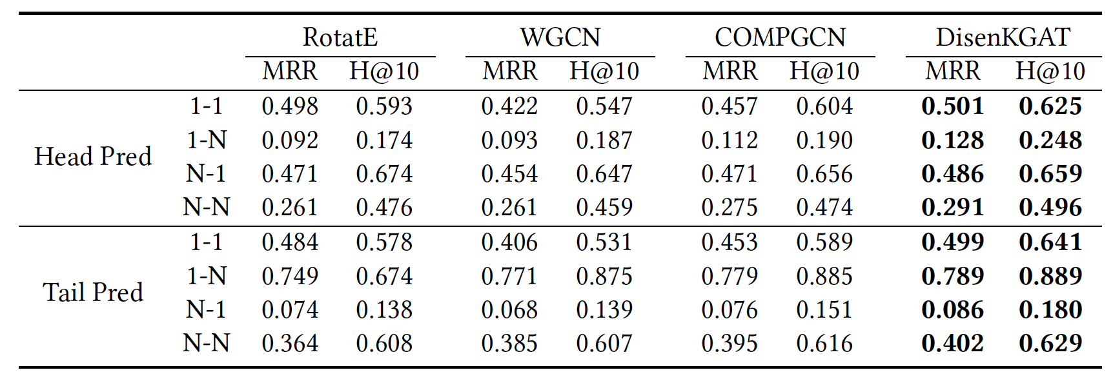
Performance
GNN-based models (W-GCN, COMPGCN) are superior to RotatE on complex relation types (1-N, N-1, N-N)
RotatE outperforms W-GCN and COMPGCN on simple relation (1-1) including symmetry/antisymmetry, composition, and inversion.
Our model outperforms other models by a large margin in both simple and complex relations.
Notes:
Focus on different types of relations which proposed before, we find that

Slide 16
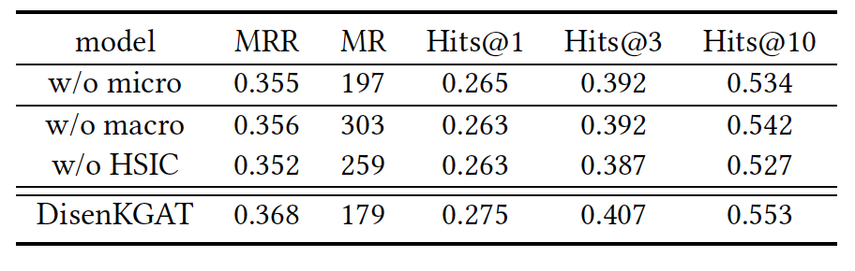
Performance
Without micro-disentanglement, the model degrades to vanilla GCN-based model.
Without macro-disentanglement, each component is prone to entangle again!
HSIC is not suitable for more complex heterogeneous graphs.
Notes:
we also investigate the impact of each module of the model such as micro and macro. We found that without micro-, the model degrades to a vanilla GCN-based model while each component is prone to entangle again without macro.HSIC is also a common measurement of correlation utilized in some tiny homogeneous graphs. However, the empirical result shows that it is not suitable for more complex heterogeneous graphs such as our knowledge graph.

Slide 17
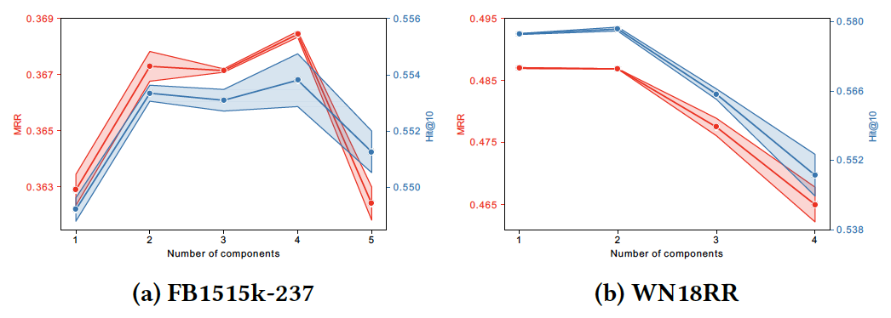
Performance
K=1, it degrades into a normal GNN-based model but coupling with attention aggregation and relation-aware mapping.
K>4, it makes some topics too fine-grained to carry crucial information.
the performance on WN18RR collapses significantly in term to its simple meaning.
Notes:
As for the Impact of component number. When we set k=1, it degrades into a normal GCN-based model but it still leads to suboptimal results owing to the attention module and relation-aware mapping. When 𝑘 > 4, the performance dramatically degrades since it makes some topics too fine-grained to carry crucial information.

Slide 18
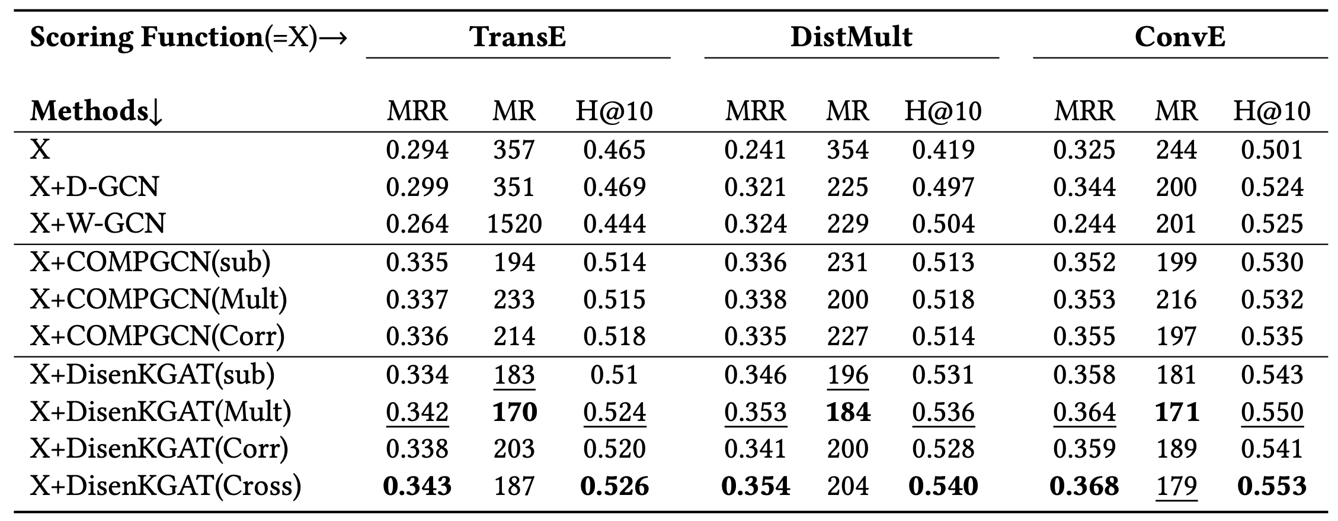
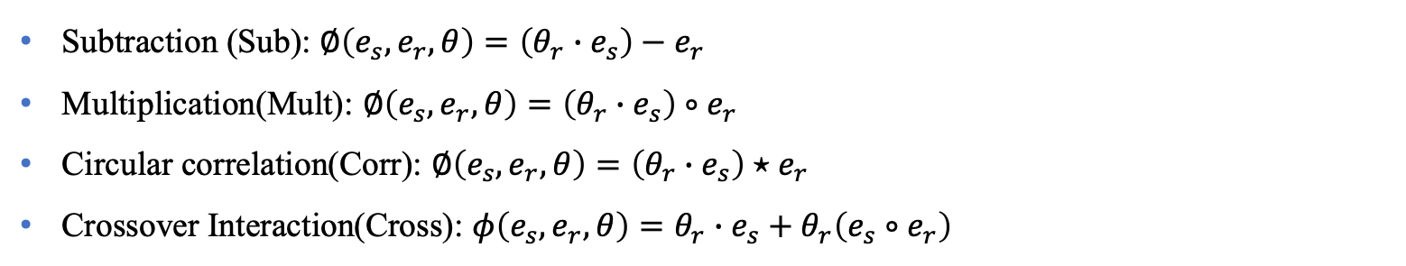
Performance
Subtraction (Sub): $∅\left(e_{s},e_{r}, θ\right)=\left(θ_{r}∙e_{s}\right)−e_{r}$
Multiplication(Mult): $∅\left(e_{s},e_{r}, θ\right)=\left(θ_{r}∙e_{s}\right)∘e_{r}$
Circular correlation(Corr): $∅\left(e_{s},e_{r}, θ\right)=\left(θ_{r}∙e_{s}\right)⋆e_{r}$
Crossover Interaction(Cross): $φ\left(e_{s},e_{r},θ\right)=θ_{r}∙e_{s}+θ_{r}\left(e_{s}∘e_{r}\right)$
Notes:
Meanwhile, our model has strong robustness in knowledge graph embedding since it could work along with multi-categories score function and has a considerable improvement.

Slide 19
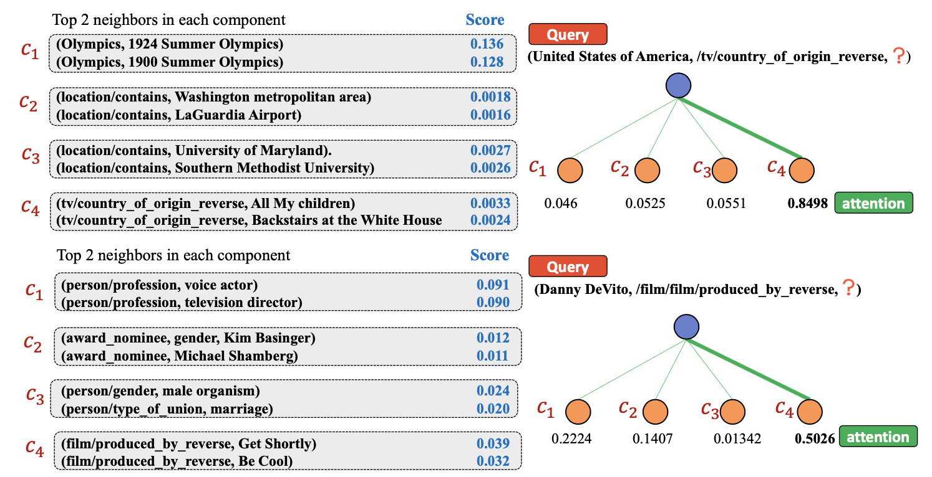
Performance
Construct a distinguishable clusters potentially.
Topic or cluster in each component of various entities should be shared all the time.
Notes:
To show an intuitive impression of our disentangled, we take the above examples. On the one hand, it could construct a distinguishable cluster potentially. In each component of the same entity, top2 neighbors have a similar topic.
And Topic or cluster in each component of various entities should be shared all the time. Therefore, the above query (the USA, tv?) and query (Danny, film) got the highest attention score in the fourth component.

Slide 20
Summary
We propose a novel Disentangled Knowledge attention network, DisenKGAT.
We take the micro-macro disentanglement into consideration simultaneously.
We look forward to explore a more general disentangled framework that could adapt to more complex scenarios.

Slide 21
Future
More flexible disentanglement combine with adaptive K.
Disentanglement in more research areas.
Contrastive learning in KG.

